Slide 1
Taking the Red Pill – Using Radeon GPU Profiler to look inside your game
(With Bonus UE4 Vulkan Update from Epic)
Jason Stewart (AMD) | Rolando Caloca O. (Epic Games) | 21 March 2018

Slide 2
Taking the Red Pill – Using Radeon GPU Profiler to look inside your game
(With Bonus UE4 Vulkan Update from Epic)
Jason Stewart (AMD) | Rolando Caloca O. (Epic Games) | 21 March 2018

Slide 3

agenda
Radeon GPU Profiler walkthrough with examples from UE4 Vulkan | Jason Stewart (AMD)
UE4 Vulkan update | Rolando Caloca O. (Epic Games)

Slide 4
Radeon GPU Profiler walkthrough
With examples from UE4 Vulkan
Jason Stewart (AMD)

Slide 5

Quick Start Guide
What is Radeon GPU Profiler?
GPU Profiler
Analyze. Adjust. Accelerate.
Notes:
<number>

Slide 6
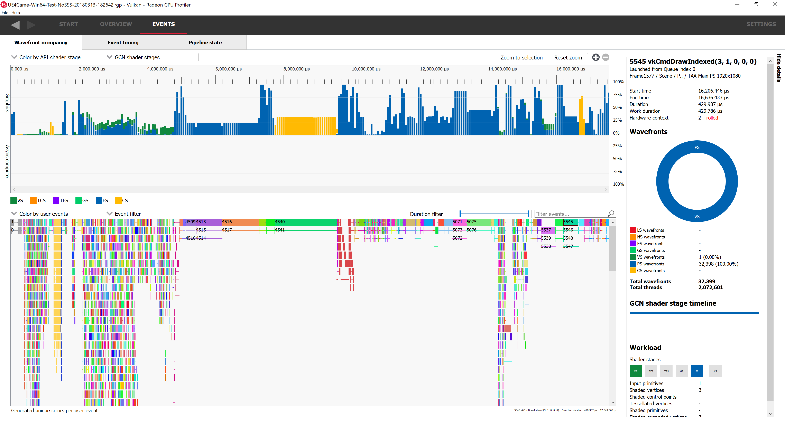
Quick Start Guide
What is Radeon GPU Profiler?
Detailed workload information
DX12 and Vulkan support
Hardware level profiling features

Slide 7
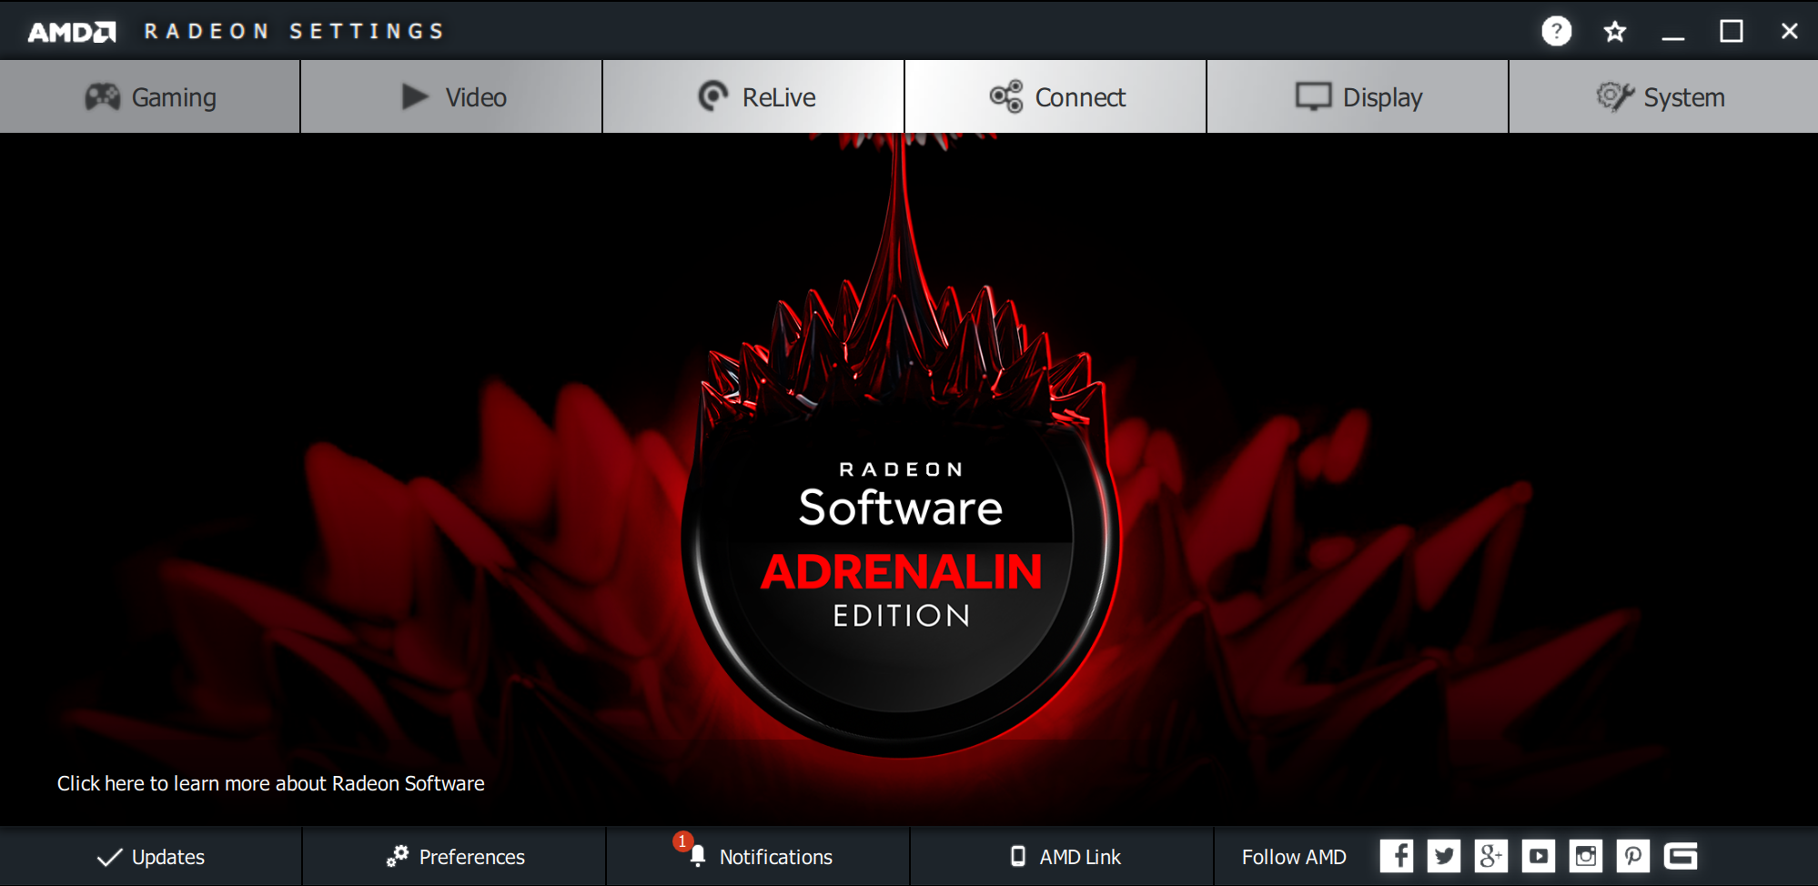
Quick Start Guide
RGP support is built directly into the production driver

Slide 8
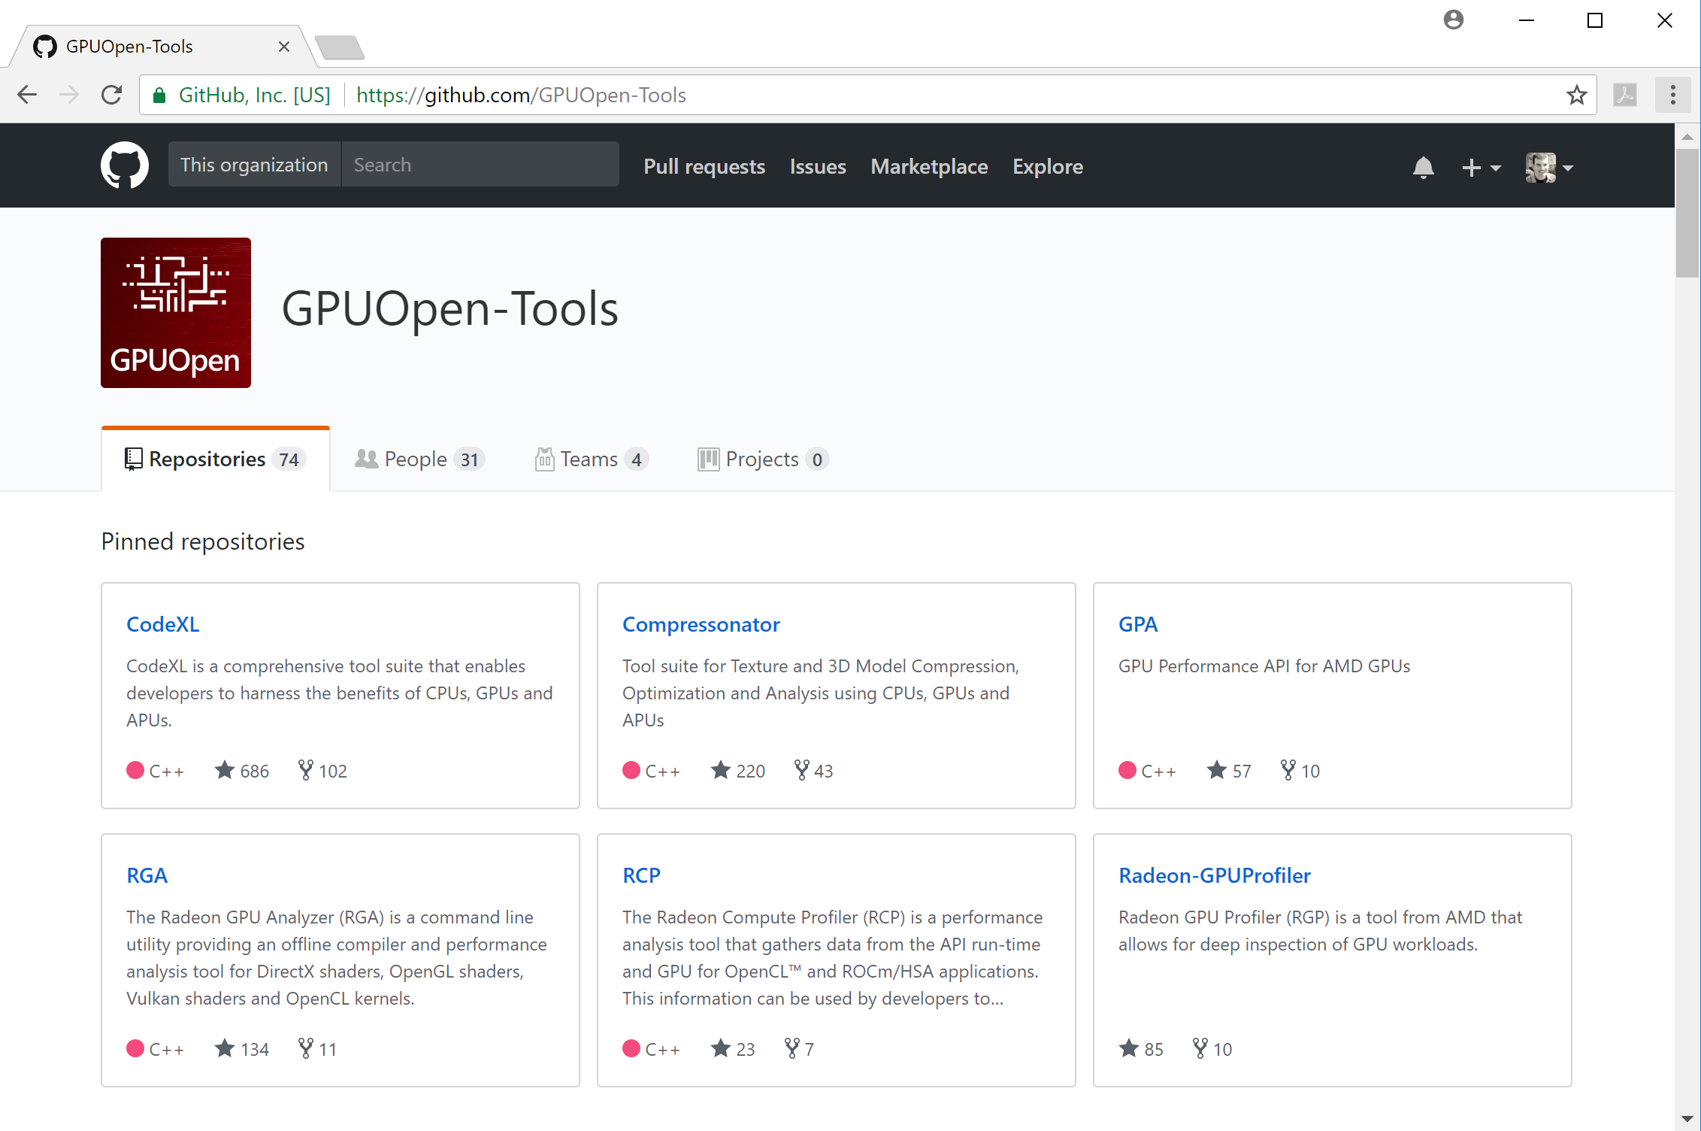
Quick Start Guide
RGP is available for free on GitHub as part of gpuopen

Slide 9

Quick Start Guide
More information on gpuopen.com
https://gpuopen.com/tag/rgp/
https://gpuopen.com/gaming-product/radeon-gpu-profiler-rgp/
Or just Google on Radeon GPU Profiler

Slide 10
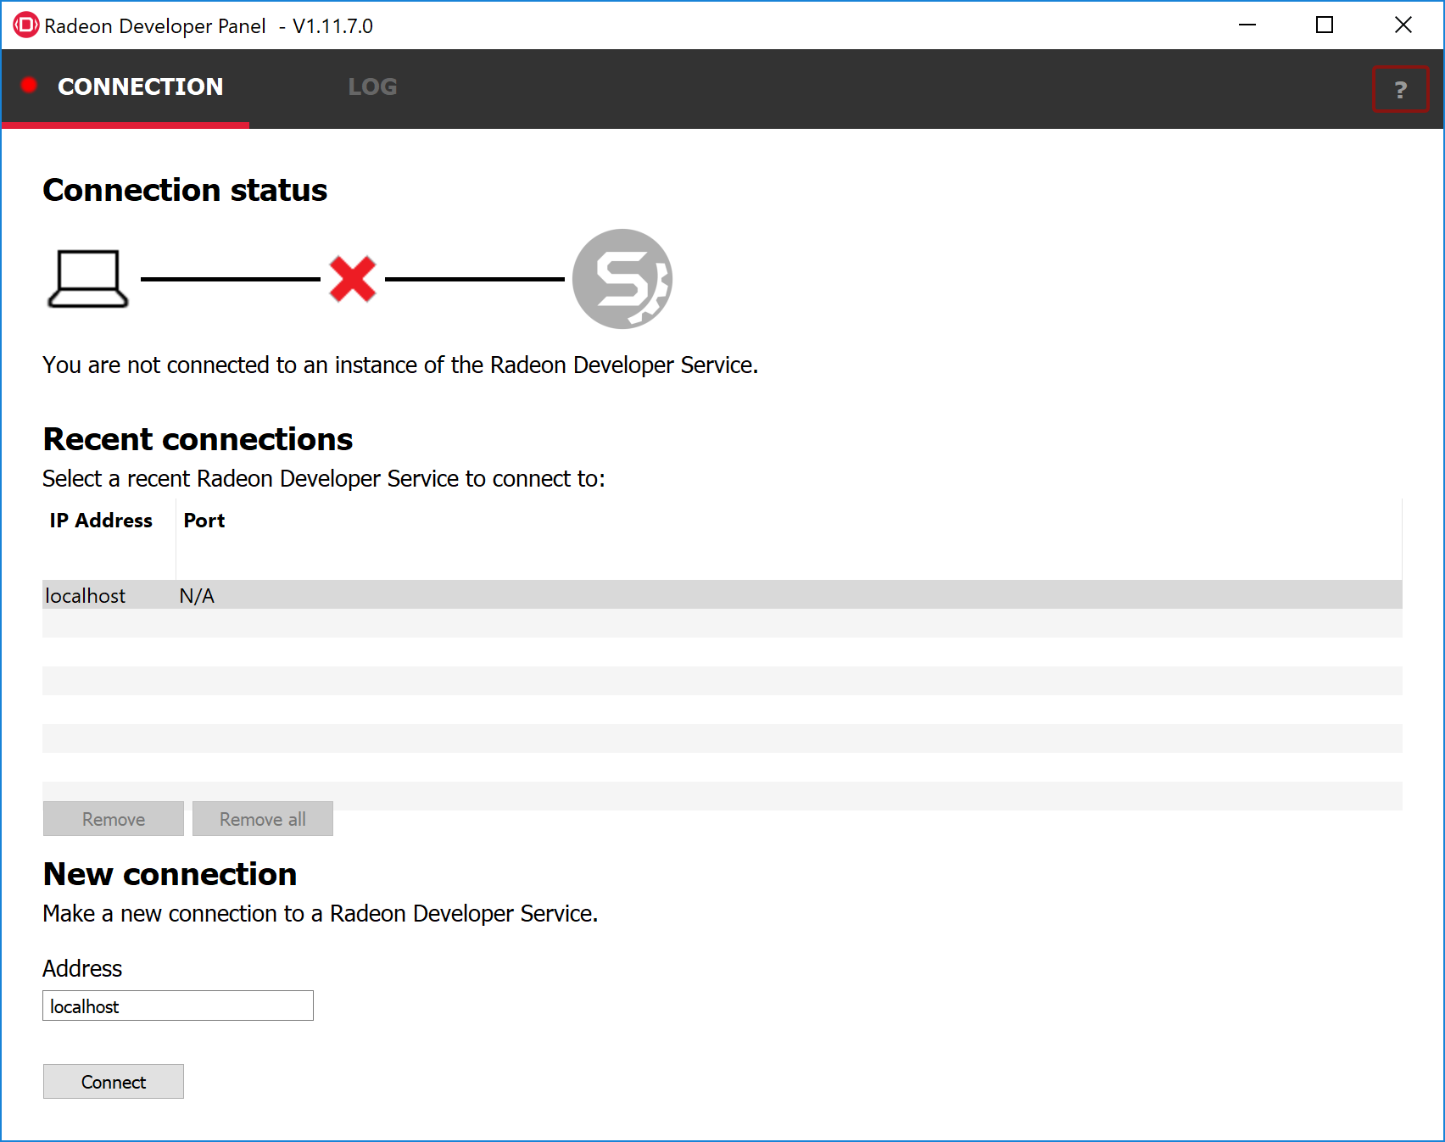
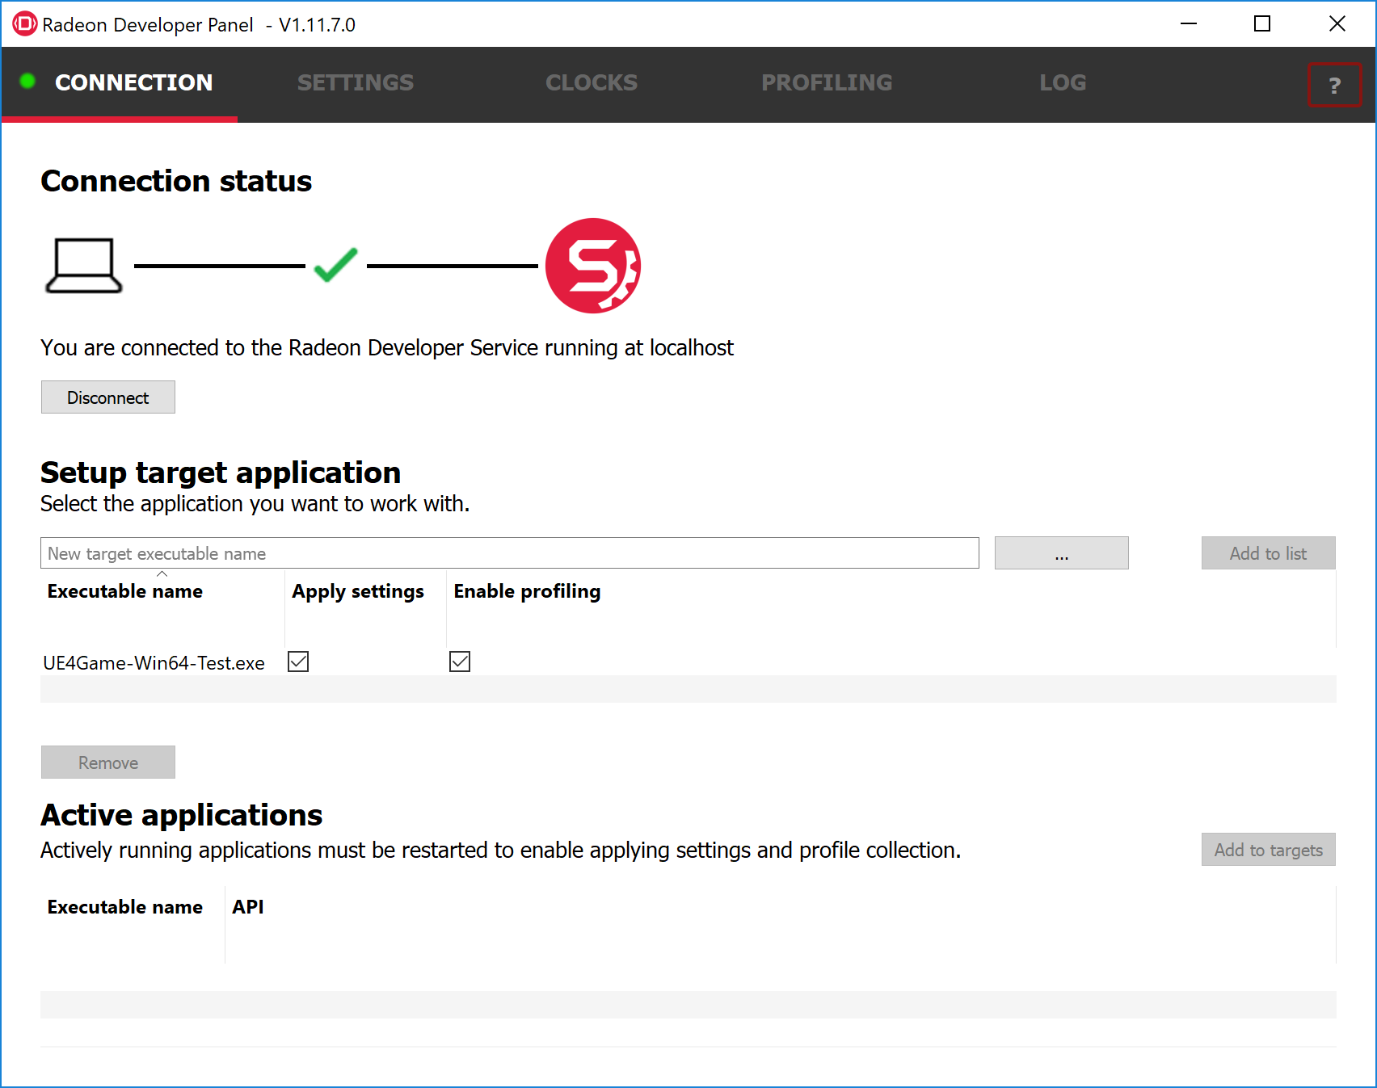
Quick Start Guide
How to capture a profile
Connect
Notes:
Connect Radeon Developer Panel to Radeon Developer Service
Set up the target application

Slide 11
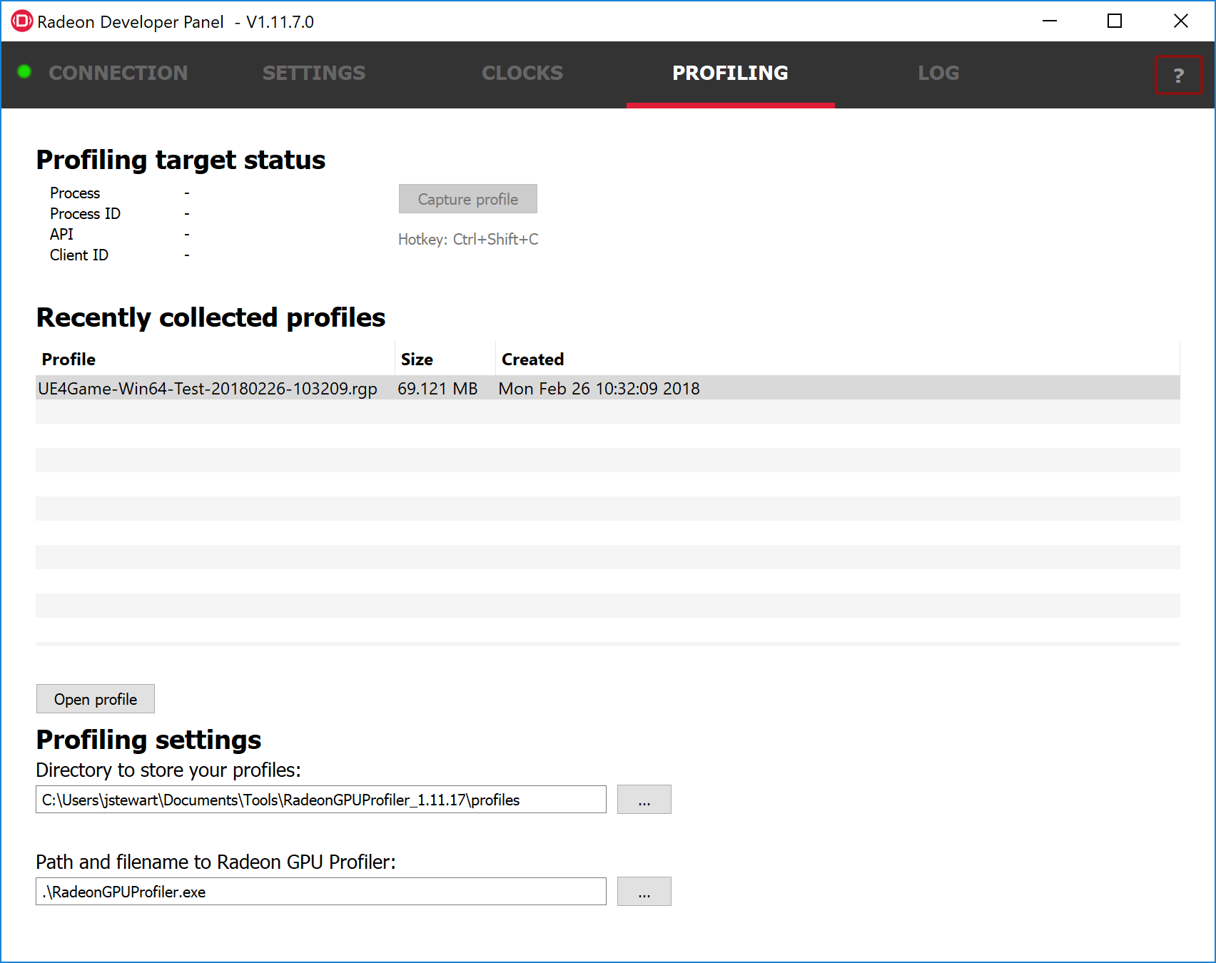

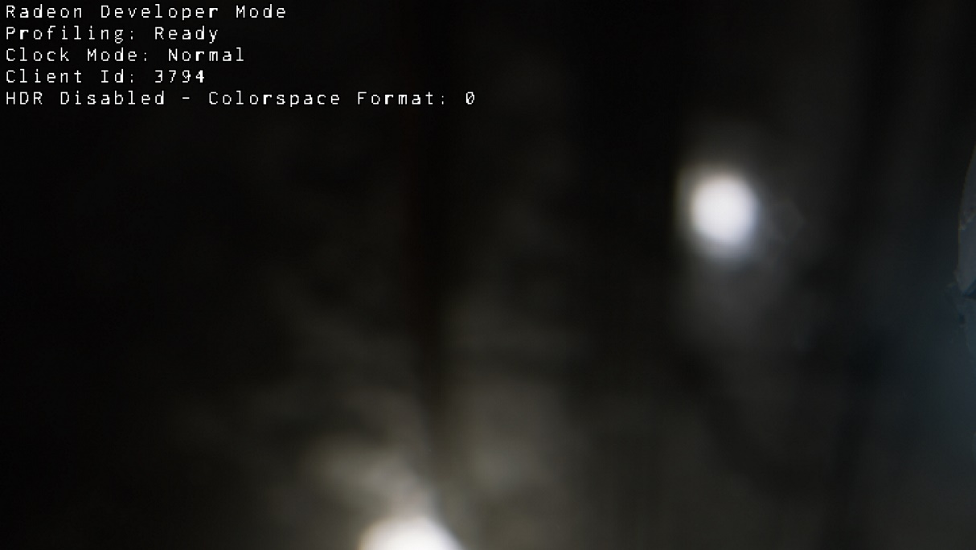
Quick Start Guide
How to capture a profile
Capture
Notes:
Launch the target application
RGP support is built directly into the production driver
Capture a trace
Double click to open in RGP

Slide 12
Quick Start Guide
Refer to the built-in help for more information
Help

Slide 13
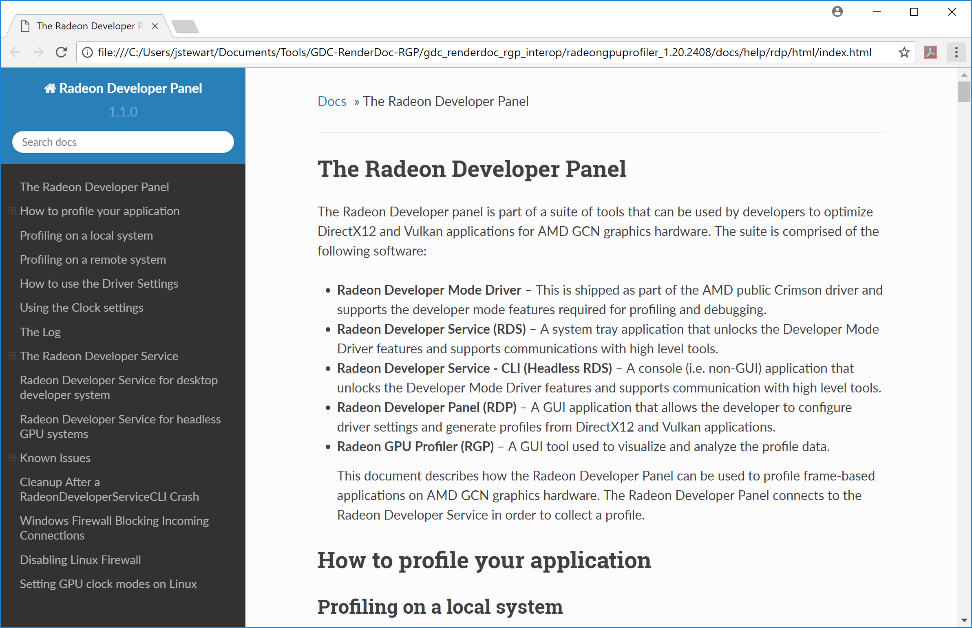
Quick Start Guide
Refer to the built-in help for more information

Slide 14
RGP/RenderDoc Interop
One slide to talk about RGP/RenderDoc Interop
Only one slide, because there will have been a full talk on this on the same day just a few hours earlier
Mention the UE4 works out of the box with RGP and RenderDoc
e.g. frame markers get enabled automatically
Needs 18.10 or newer driver
Notes:
VK_EXT_debug_marker, vkCmdDebugMarkerBeginEXT, vkCmdDebugMarkerEndEXT
EnableIdealGPUCaptureOptions
<number>

Slide 15
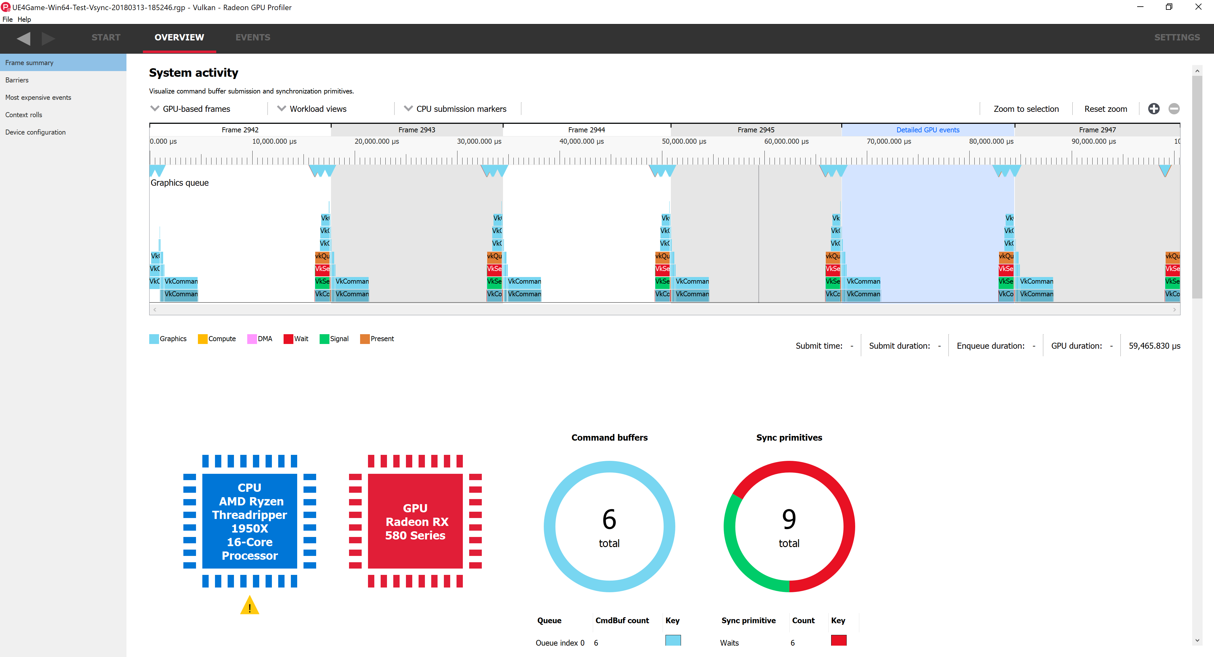
Viewing a capture in RGP
Where to start
Notes:
SunTemple at 1080p with vsync enabled, present bound
18.10 driver includes present packets in the system activity display
This slide is to point out the new present packet display and to emphasize that you want to get out of this situation (vsync bound) when profiling
For profiling, prefer VK_PRESENT_MODE_IMMEDIATE_KHR (i.e. disable vsync)?
If so, can we do this automatically in UE4 code, like we enable frame markers?
<number>

Slide 16
Viewing a capture in RGP
Where to start
Placeholder
Notes:
Show no vsync, but still not right
Broken query system, for example
<number>

Slide 17
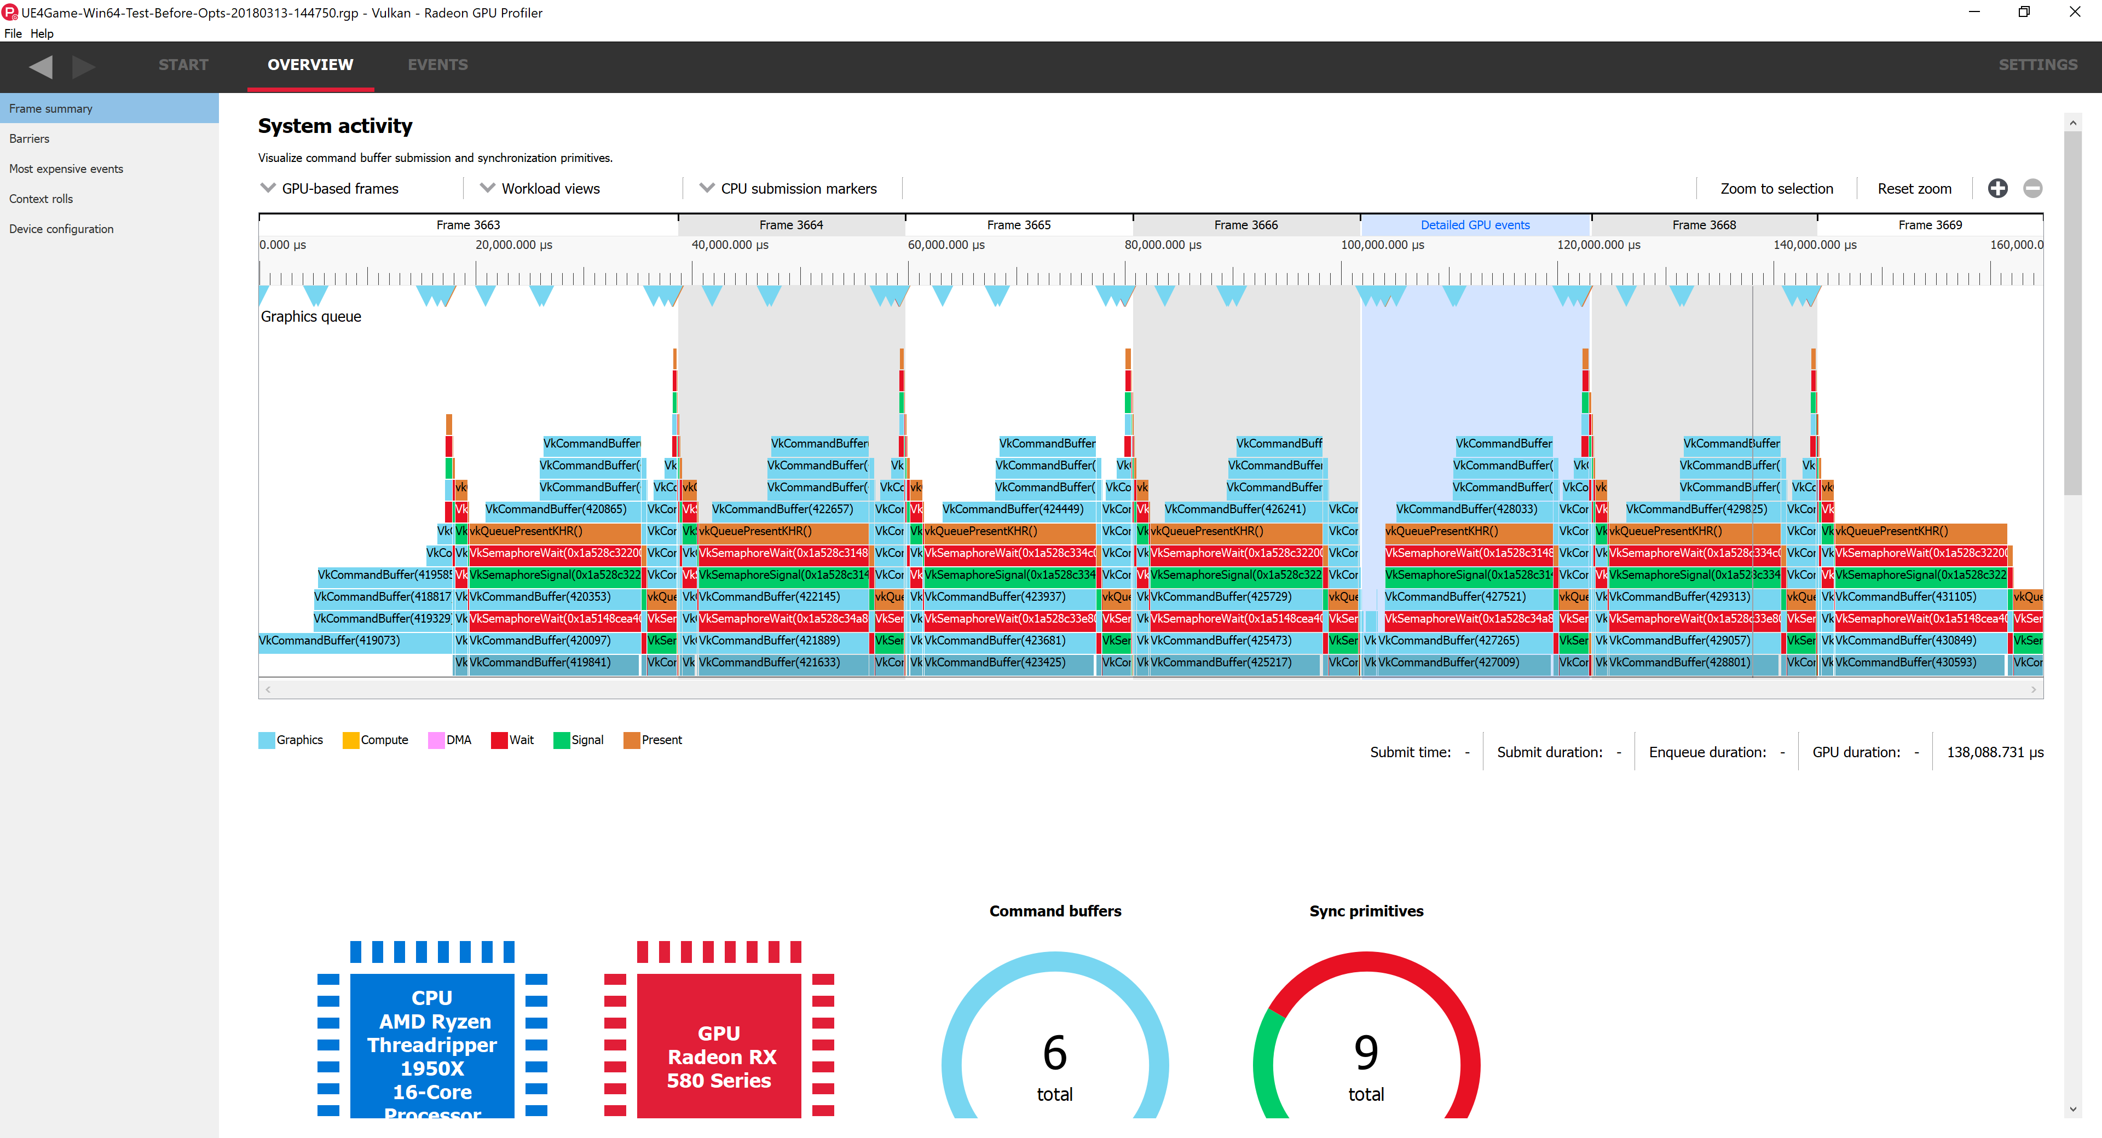
Viewing a capture in RGP
Where to start
Notes:
You want to see something more like this
Vsync disabled, no CPU-GPU sync points, no GPU idle time, GPU bound
You want to make sure you have this part right, the CPU-side feeding of the GPU, before continuing
<number>

Slide 18
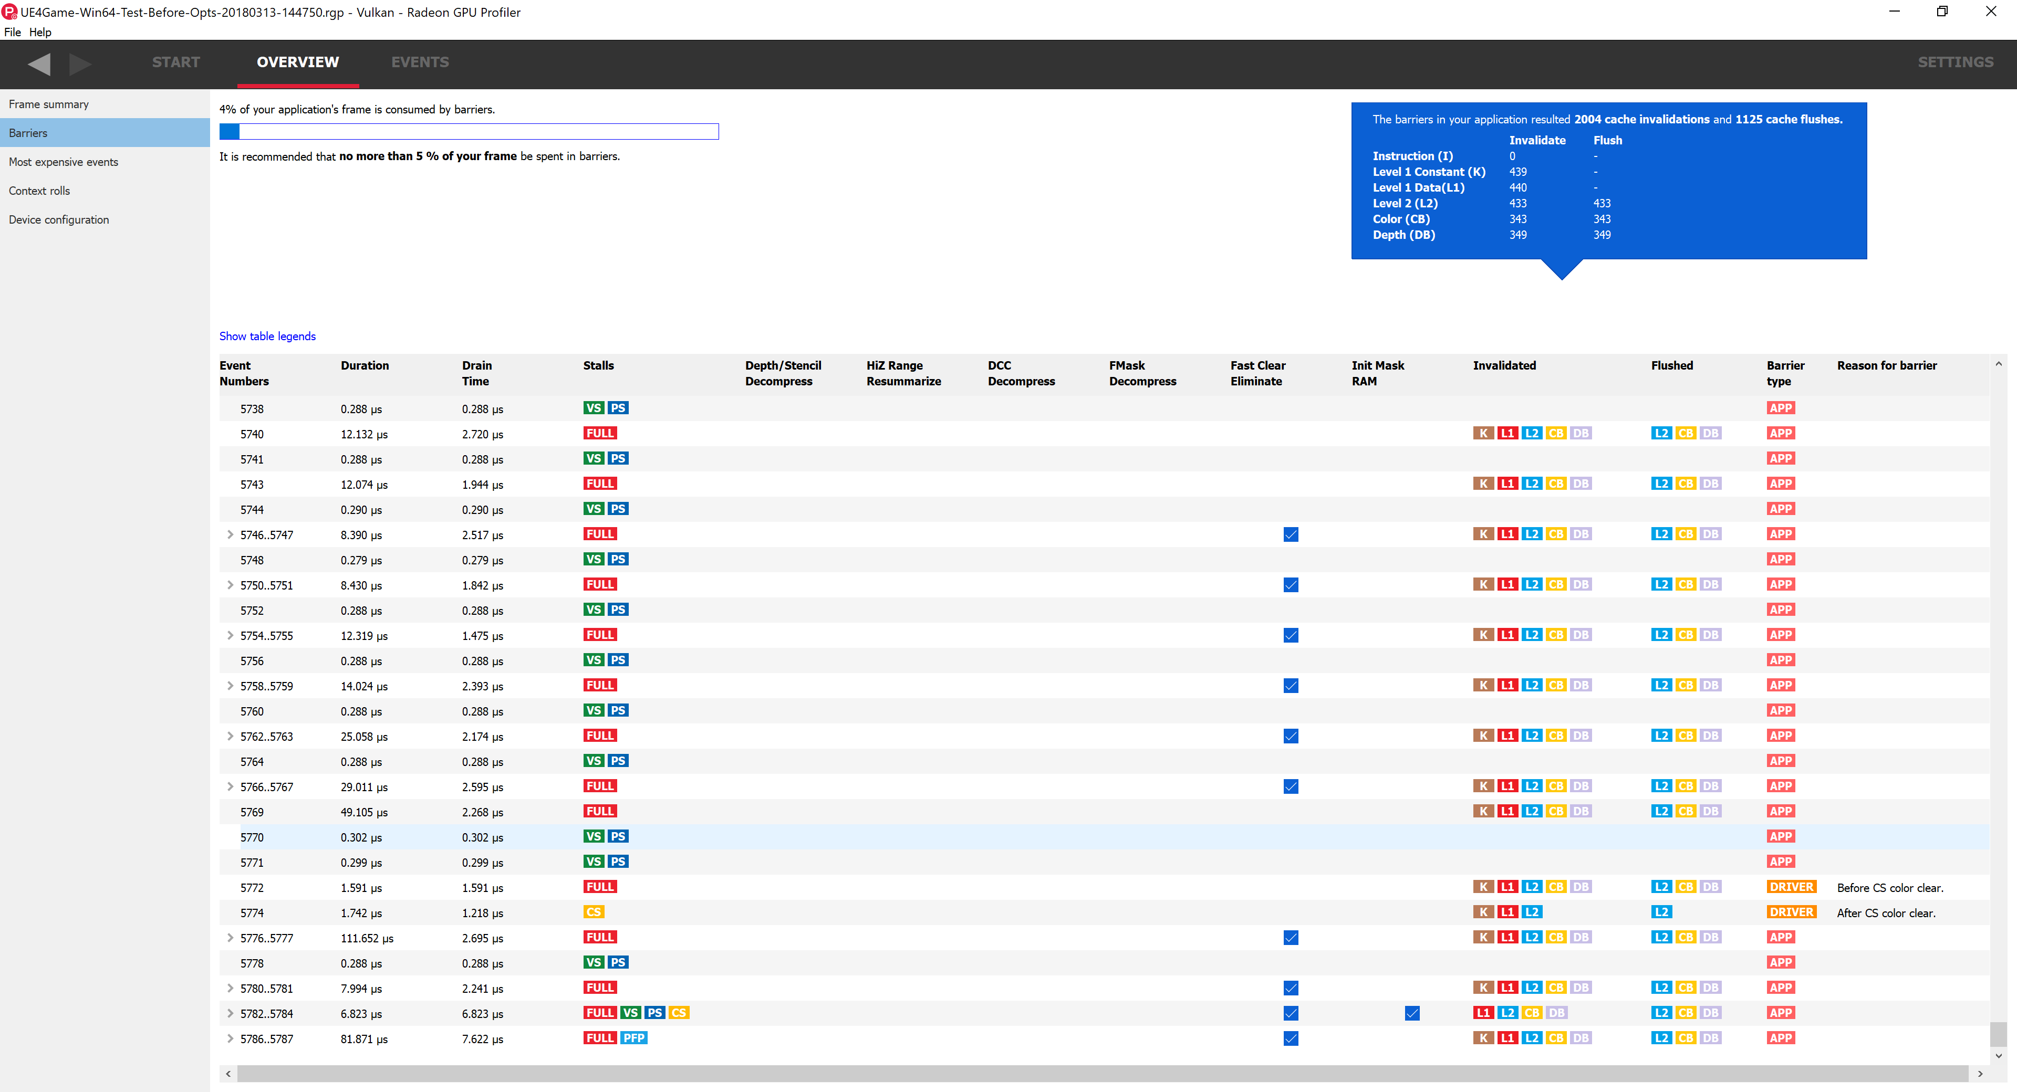
Viewing a capture in RGP
Where to start
Notes:
Barrier reason codes
Also mention that fast clear eliminate and init mask RAM are to be expected
But you want to try to avoid the other cases
Depth/stencil decompress, DCC decompress, etc.
<number>

Slide 19
Viewing a capture in RGP
Where to start
Talk about the other things available in the overview tab
Most expensive events
Context rolls
Device configuration
This part might be brief, depending on if we have any particularly interesting UE4 Vulkan examples to talk about

Slide 20
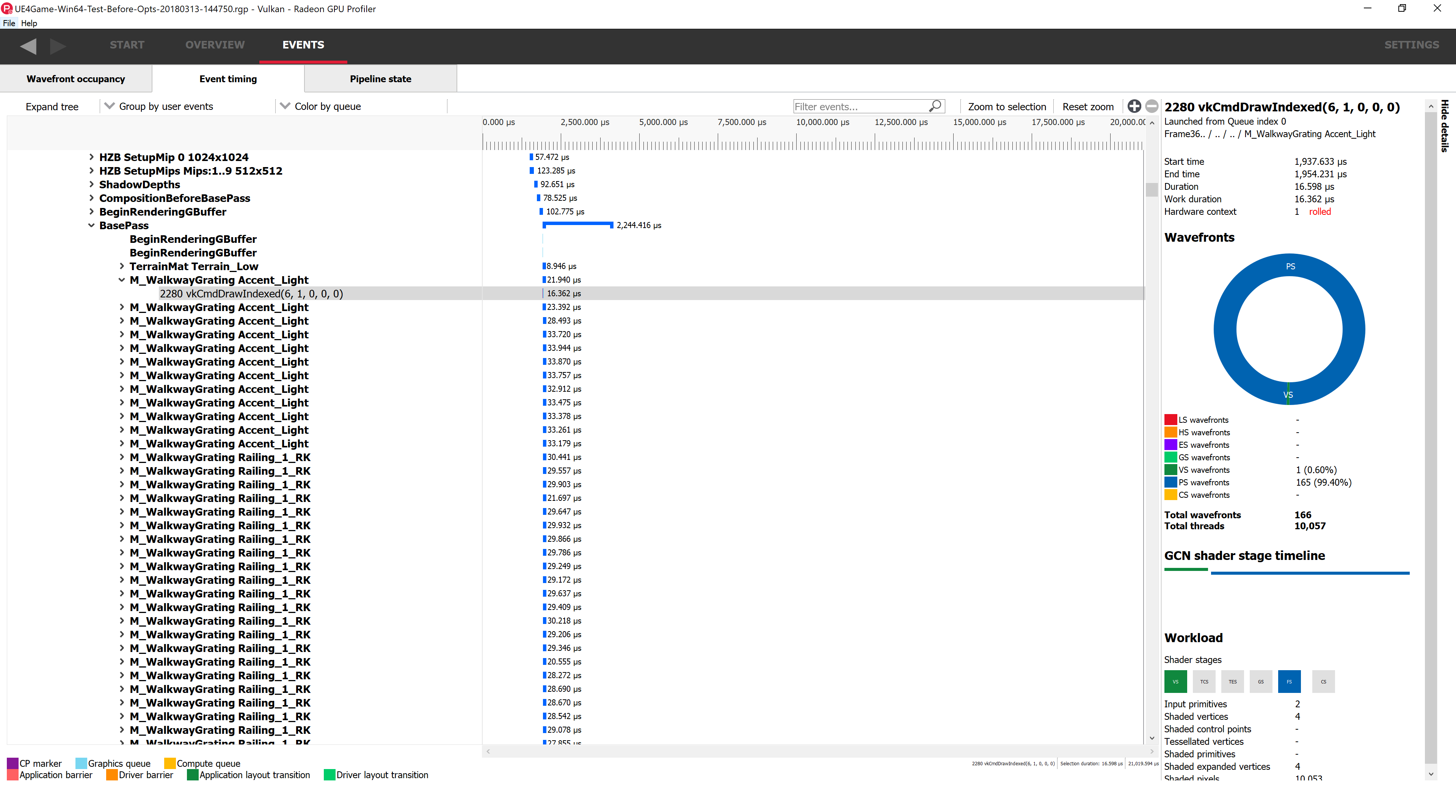
Event Timing
Notes:
Do before and after depth bounds test
Frame it in the context of making sure any DX-only optimizations are brought over to your Vulkan path
<number>

Slide 21
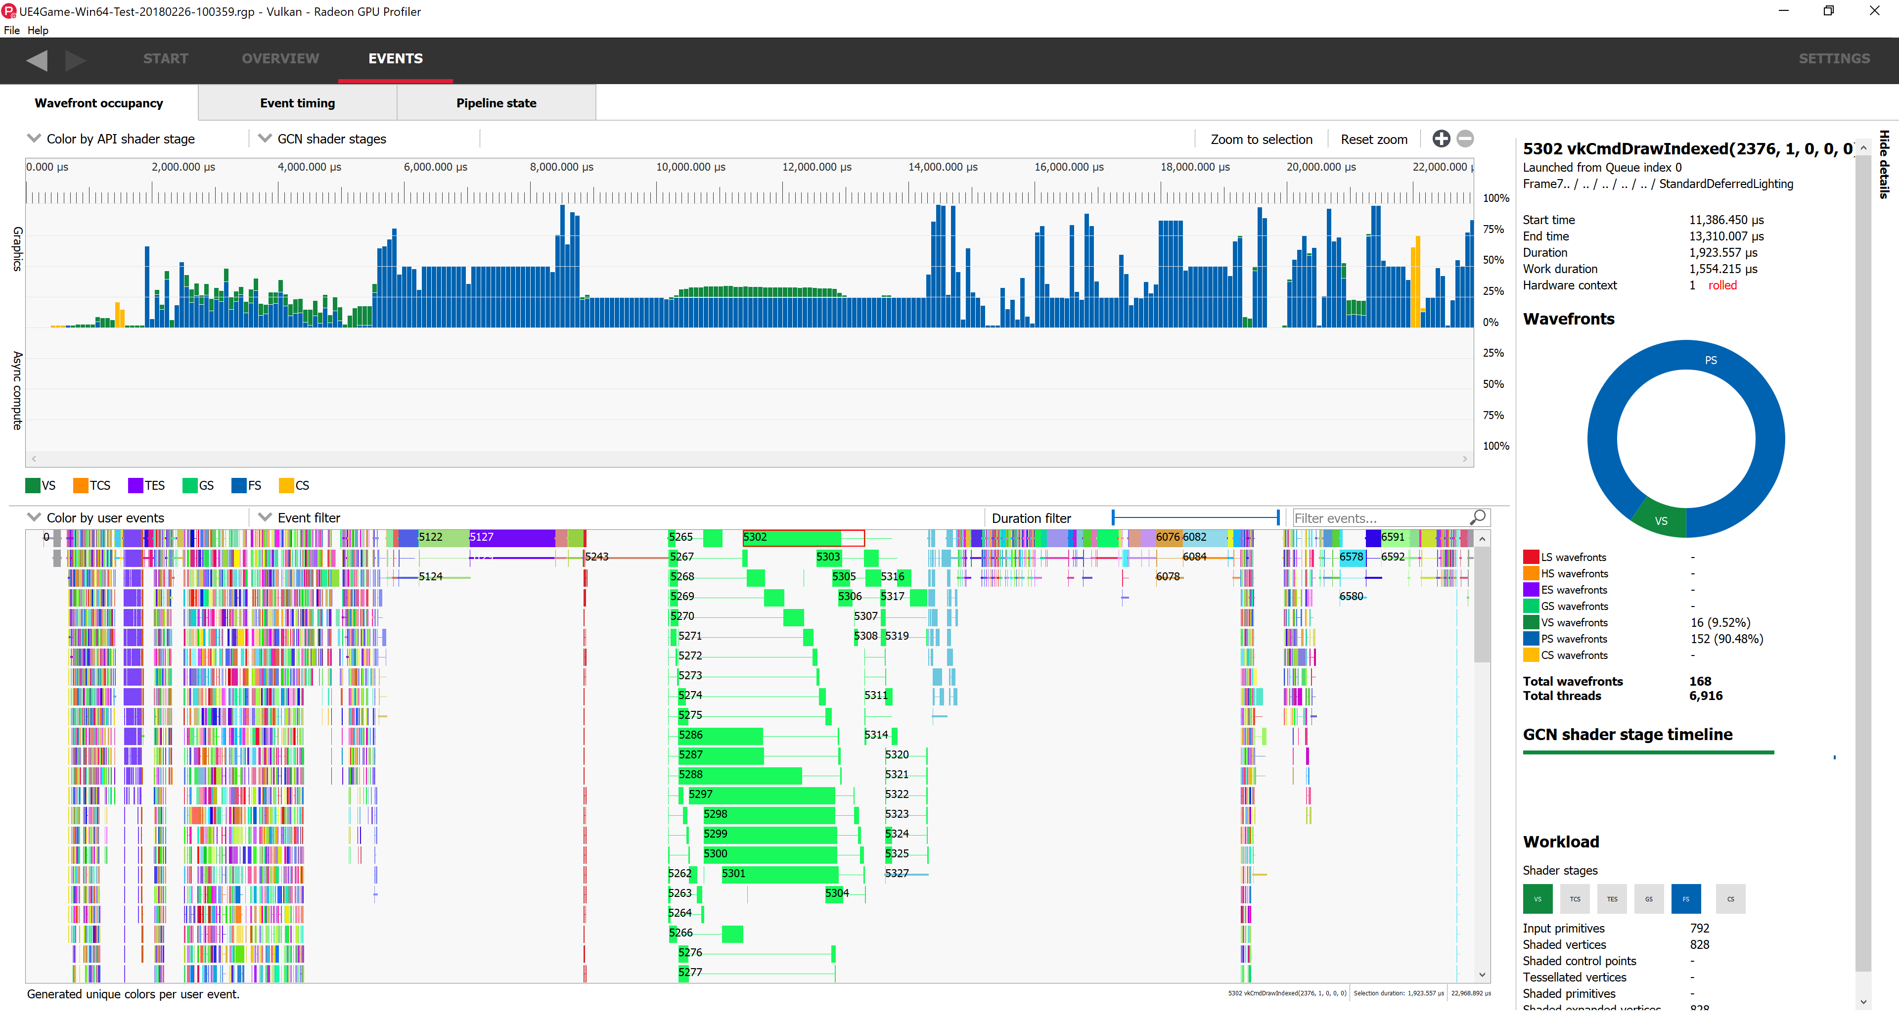
Wavefront Occupancy
Occupancy
Graph
GPU
Events

Slide 22
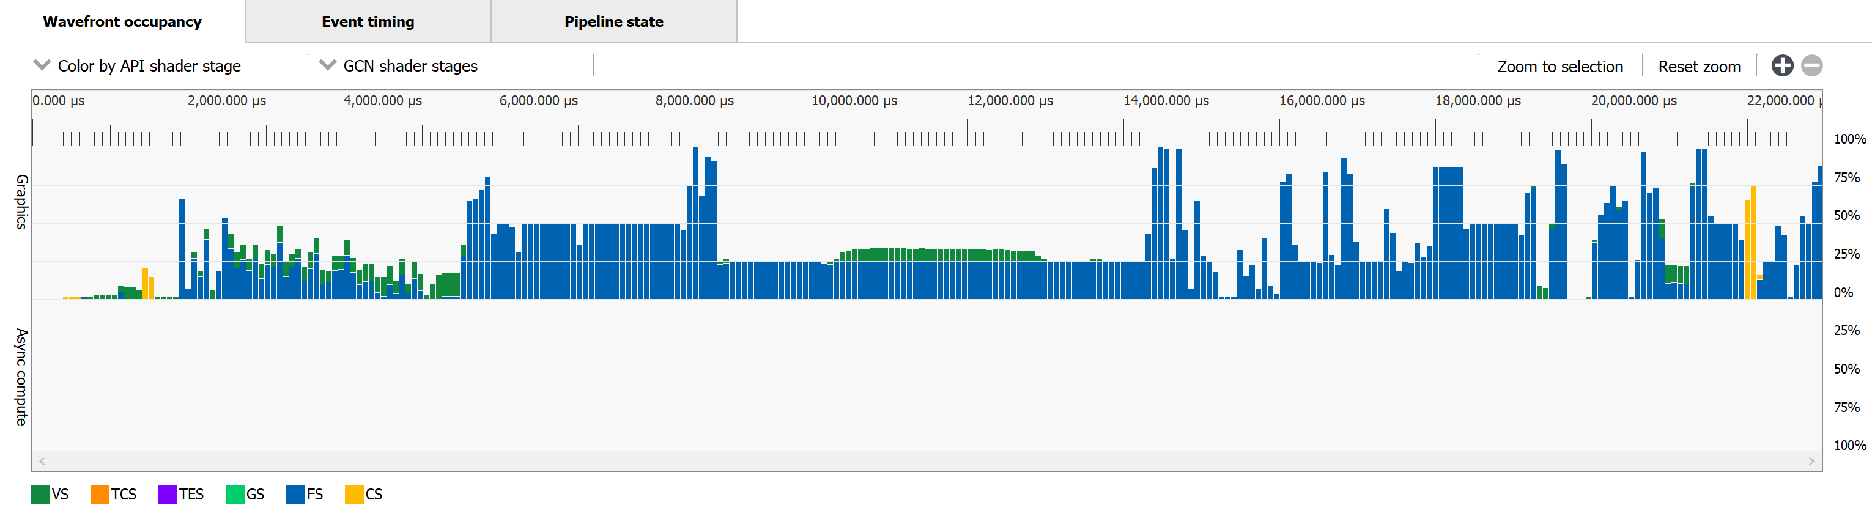
Wavefront Occupancy
What’s a wavefront?
?

Slide 23
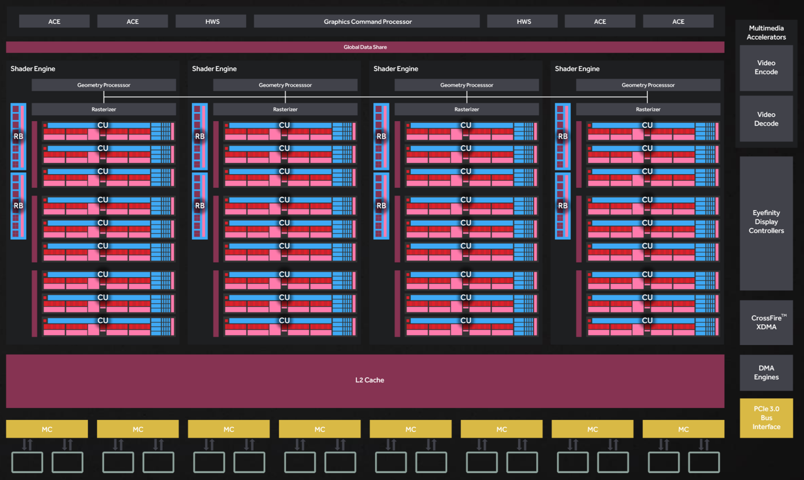
GCN Architecture
X Shader Engines per Chip with Y Compute Units per Shader Engine
Notes:
This particular diagram is for Polaris, specifically Polaris10 "Ellesmere“, i.e. RX 480/580
<number>

Slide 24
GCN Architecture
X Shader Engines per Chip with Y Compute Units per Shader Engine
Notes:
This particular diagram is for Polaris, specifically Polaris10 "Ellesmere“, i.e. RX 480/580
<number>

Slide 25
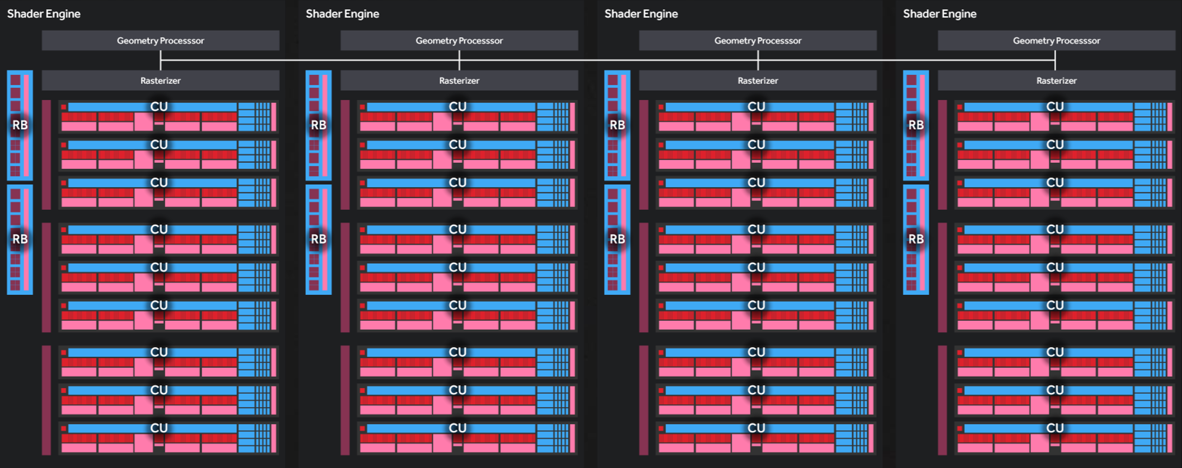
GCN Architecture
X Shader Engines per Chip
Notes:
RX 580 has this configuration
Compute Units: 36
ROPs: 32
Stream Processors: 2304
Texture Units: 144
Once pixels have been shaded, they are typically sent to the render back-ends (RBs) for depth and stencil tests and any blending before the final output to the display
36 CUs with 4 SIMDs per CU and a 16x VALU per SIMD that can do 2 floating point ops per clock equals …
36×4×16=2304 Stream Processors
2304×2=4608 FLOPs per clock
4608 FLOPs per clock at 1340 MHz boost clock equals …
4608×1340000000=6174720000000
6.2 TFLOPs
<number>

Slide 26
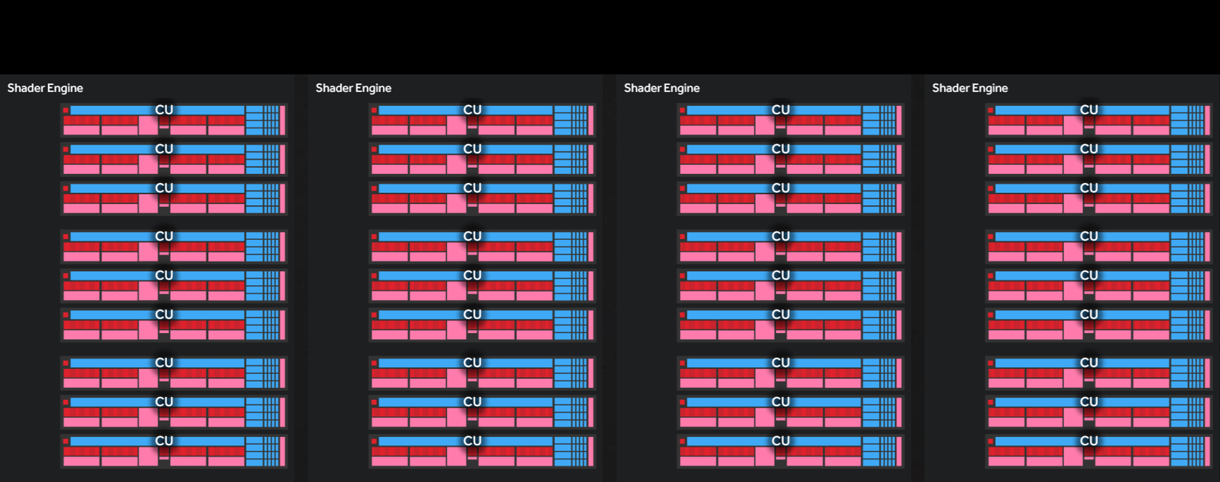
GCN Architecture
X Shader Engines per Chip with Y Compute Units per Shader Engine
Notes:
RX 580 has this configuration
Compute Units: 36
Stream Processors: 2304
Texture Units: 144
36 CUs with 4 SIMDs per CU and a 16x VALU per SIMD that can do 2 floating point ops per clock equals …
36×4×16=2304 Stream Processors
2304×2=4608 FLOPs per clock
4608 FLOPs per clock at 1340 MHz boost clock equals …
4608×1340000000=6174720000000
6.2 TFLOPs
<number>

Slide 27
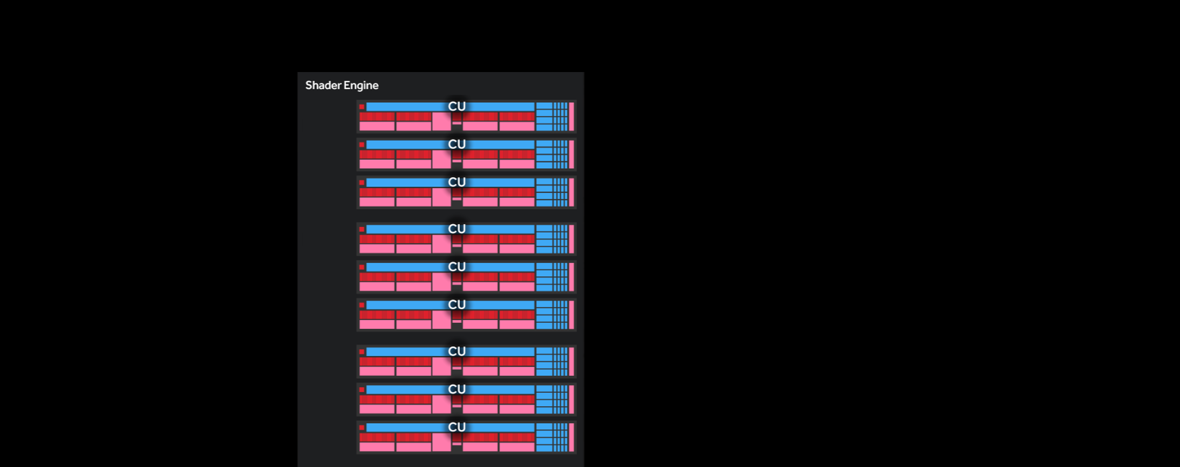
GCN Architecture
Y Compute Units per Shader Engine
Notes:
RX 580 has this configuration
Compute Units: 36
Stream Processors: 2304
Texture Units: 144
<number>

Slide 28
GCN Compute Unit
4 SIMD Units per CU
Branch & Message Unit
Scheduler
Tex
L1
LDS
SALU
Tex
VALU
VALU
VALU
VALU
Tex
VGPR
VGPR
SGPR
VGPR
VGPR
Tex
Notes:
<number>

Slide 29
GCN Compute Unit
4 SIMD Units per CU
Branch & Message Unit
Scheduler
Tex
L1
LDS
SALU
Tex
VALU
VALU
VALU
VALU
Tex
VGPR
VGPR
SGPR
VGPR
VGPR
Tex
Notes:
<number>

Slide 30
GCN Compute Unit
4 SIMD Units per CU
VALU
VALU
VALU
VALU
VGPR
VGPR
VGPR
VGPR
Notes:
<number>

Slide 31
GCN Compute Unit
4 SIMD Units per CU
SIMD
SIMD
SIMD
SIMD
VALU
VALU
VALU
VALU
VGPR
VGPR
VGPR
VGPR
Notes:
<number>

Slide 32
GCN Compute Unit
What’s a wavefront?
SIMD
SIMD
SIMD
SIMD
Notes:
<number>

Slide 33
GCN Compute Unit
What’s a wavefront?
SIMD = Single instruction, multiple data
What’s the multiple?
The GPU works on 64-thread groups called wavefronts (or waves)
Smallest unit of GPU work
Each wavefront shares a single program counter
Each SIMD is executing an independent wavefront
16-lane vector ALU per SIMD
Each SIMD cycles through the 64 work items in a wavefront
16-lane vector ALU
SIMD
SIMD
64KB VGPR Memory
Notes:
A wavefront or wave is a collection of 64 work items grouped for efficient processing on the compute unit
Each wavefront shares a single program counter
Each SIMD is executing an independent wavefront
Each SIMD includes a 16-lane vector pipeline
Each SIMD simultaneously executes a single operation across 16 work items (threads)
A wavefront is issued to a SIMD in a single cycle, but takes 4 cycles to execute operations for all 64 work items
That is, each SIMD operates on wavefronts of 64 work-items over four clock cycles
Many wavefronts can be processed in parallel
<number>

Slide 34
GCN Compute Unit
Multiple Waves in flight per SIMD
A GCN Compute Unit supports having up to 8 or 10 wavefronts in flight per SIMD “at once”
Helps hide memory latency
Compute Unit scheduler can switch to another wavefront on a SIMD when a memory fetch stalls a shader program
16-lane vector ALU
SIMD
Wave 0
Wave 1
Wave 2
Wave 3
Wave 4
Wave 5
Wave 6
Wave 7
64KB VGPR Memory
Notes:
A wavefront or wave is a collection of 64 work items grouped for efficient processing on the compute unit
Each wavefront shares a single program counter
Each SIMD is executing an independent wavefront
Each SIMD includes a 16-lane vector pipeline
Each SIMD simultaneously executes a single operation across 16 work items (threads)
A wavefront is issued to a SIMD in a single cycle, but takes 4 cycles to execute operations for all 64 work items
That is, each SIMD operates on wavefronts of 64 work-items over four clock cycles
Many wavefronts can be processed in parallel
<number>

Slide 35
GCN Compute Unit
Multiple Waves in flight per SIMD
A GCN Compute Unit supports having up to 8 or 10 wavefronts in flight per SIMD “at once”
Helps hide memory latency
Compute Unit scheduler can switch to another wavefront on a SIMD when a memory fetch stalls a shader program
16-lane vector ALU
Wave 0
Wave 1
Wave 2
Wave 3
Wave 0
Wave 1
Wave 4
Wave 5
Wave 6
Wave 7
Notes:
A wavefront or wave is a collection of 64 work items grouped for efficient processing on the compute unit
Each wavefront shares a single program counter
Each SIMD is executing an independent wavefront
Each SIMD includes a 16-lane vector pipeline
Each SIMD simultaneously executes a single operation across 16 work items (threads)
A wavefront is issued to a SIMD in a single cycle, but takes 4 cycles to execute operations for all 64 work items
That is, each SIMD operates on wavefronts of 64 work-items over four clock cycles
Many wavefronts can be processed in parallel
<number>

Slide 36
Wavefront Occupancy
Live Demo
Several traces from UE4 will be shown

Slide 37
WavefronT Occupancy
One slide on why, if lower VGPR usage is desirable, why doesn’t the AMD driver shader compiler just force lower VGPR usage

Slide 38
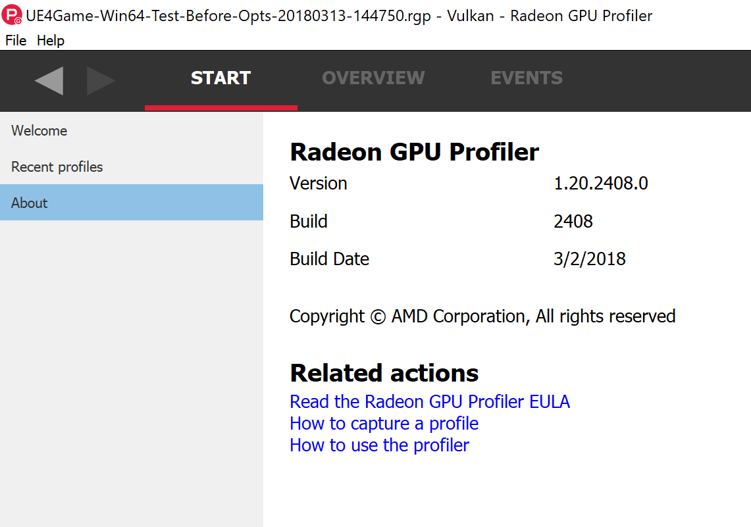
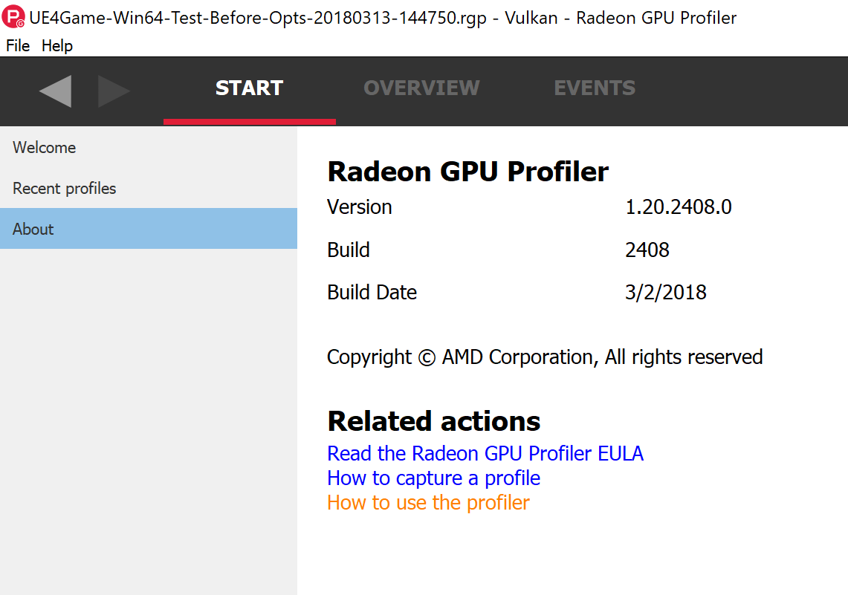

Radeon GPU Profiler
Refer to the built-in help for more information
Help

Slide 39
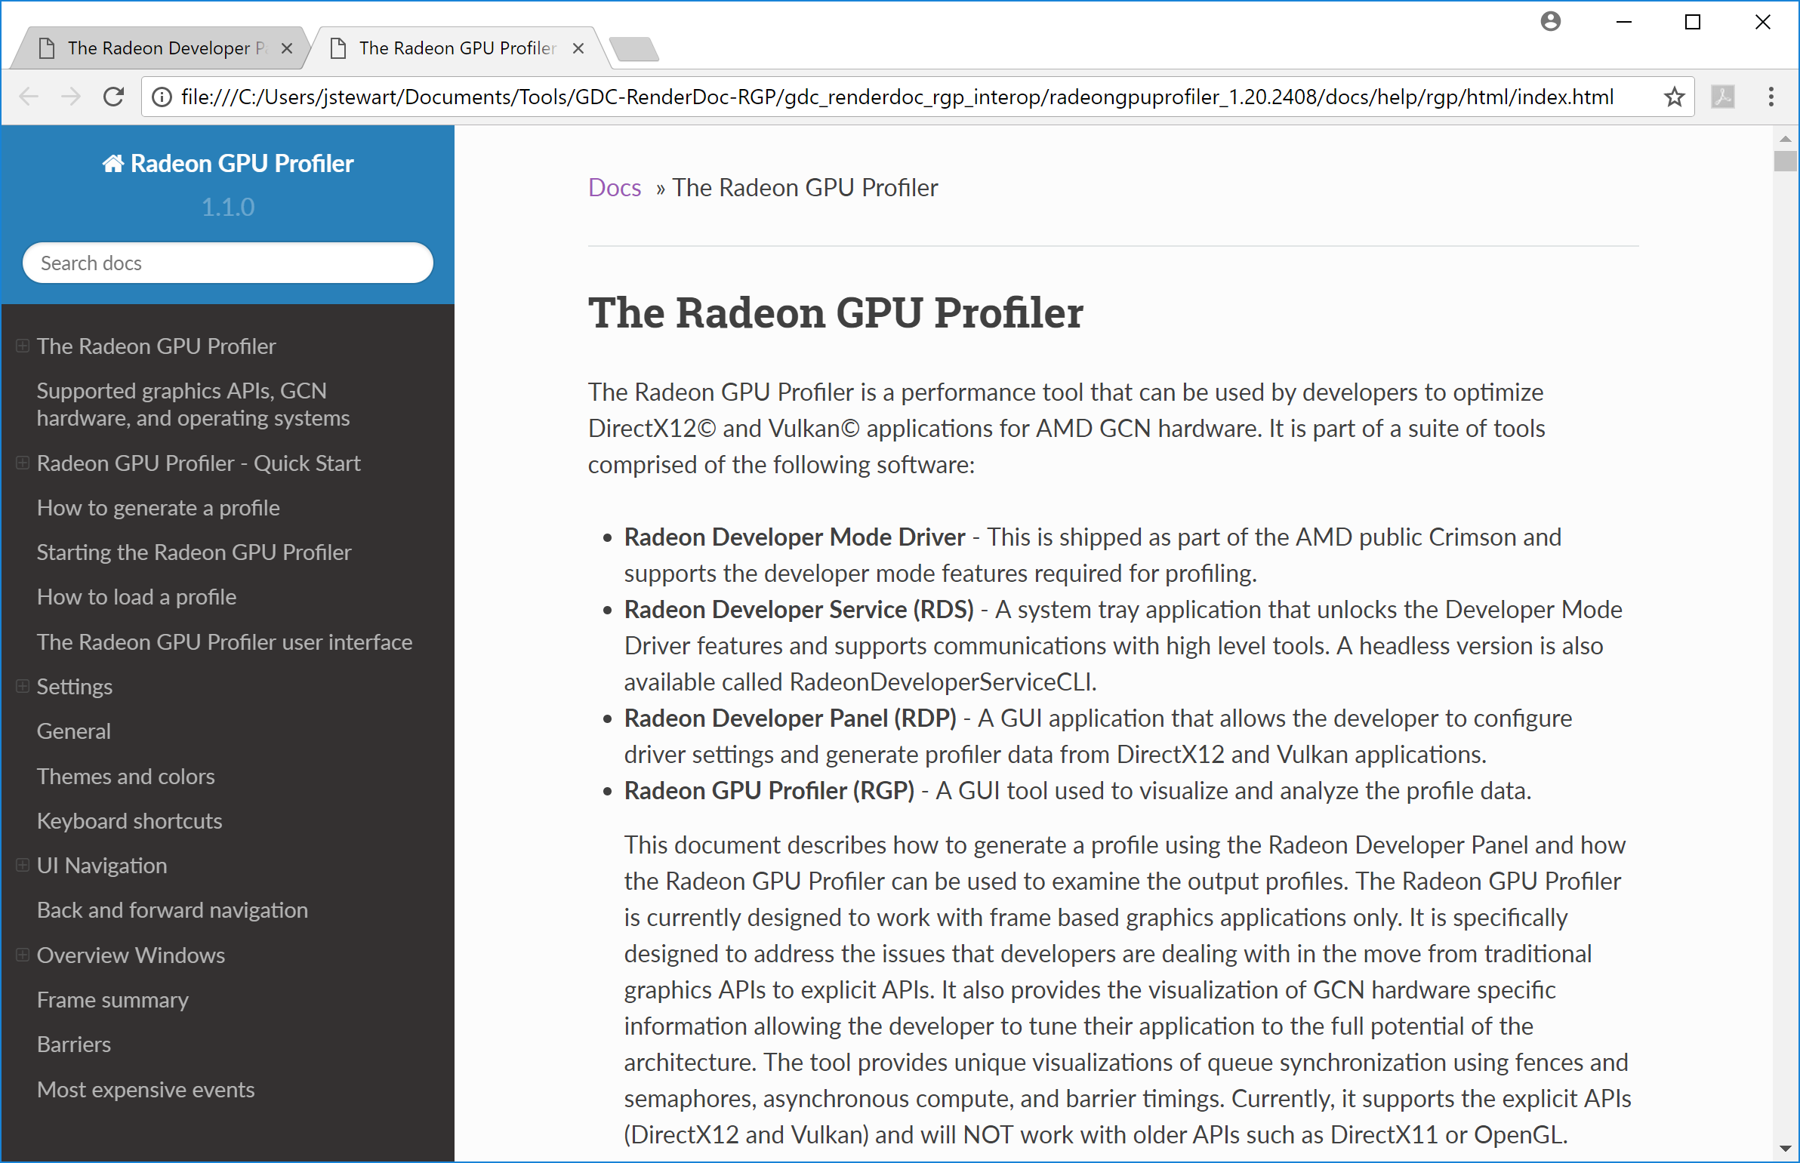
Radeon GPU Profiler
Refer to the built-in help for more information

Slide 42
Disclaimer & Attribution
The information presented in this document is for informational purposes only and may contain technical inaccuracies, omissions and typographical errors.
The information contained herein is subject to change and may be rendered inaccurate for many reasons, including but not limited to product and roadmap changes, component and motherboard version changes, new model and/or product releases, product differences between differing manufacturers, software changes, BIOS flashes, firmware upgrades, or the like. AMD assumes no obligation to update or otherwise correct or revise this information. However, AMD reserves the right to revise this information and to make changes from time to time to the content hereof without obligation of AMD to notify any person of such revisions or changes.
AMD MAKES NO REPRESENTATIONS OR WARRANTIES WITH RESPECT TO THE CONTENTS HEREOF AND ASSUMES NO RESPONSIBILITY FOR ANY INACCURACIES, ERRORS OR OMISSIONS THAT MAY APPEAR IN THIS INFORMATION.
AMD SPECIFICALLY DISCLAIMS ANY IMPLIED WARRANTIES OF MERCHANTABILITY OR FITNESS FOR ANY PARTICULAR PURPOSE. IN NO EVENT WILL AMD BE LIABLE TO ANY PERSON FOR ANY DIRECT, INDIRECT, SPECIAL OR OTHER CONSEQUENTIAL DAMAGES ARISING FROM THE USE OF ANY INFORMATION CONTAINED HEREIN, EVEN IF AMD IS EXPRESSLY ADVISED OF THE POSSIBILITY OF SUCH DAMAGES.
ATTRIBUTION
© 2018 Advanced Micro Devices, Inc. All rights reserved. AMD, the AMD Arrow logo and combinations thereof are trademarks of Advanced Micro Devices, Inc. in the United States and/or other jurisdictions. Other names are for informational purposes only and may be trademarks of their respective owners.

Slide 43

UE4 Vulkan update
Rolando Caloca O. (Epic Games)

Slide 44
Backup slides

Slide 45
Radeon RX 580
Specs
Compute Units: 36
Base Frequency: Up to 1257 MHz
Boost Frequency: Up to 1340 MHz
Peak Pixel Fill-Rate: Up to 42.88 GP/s
Peak Texture Fill-Rate: Up to 192.96 GT/s
Max Performance: Up to 6.2 TFLOPs
ROPs: 32
Stream Processors: 2304
Texture Units: 144
Transistor Count: 5.7 B

